Slide 1
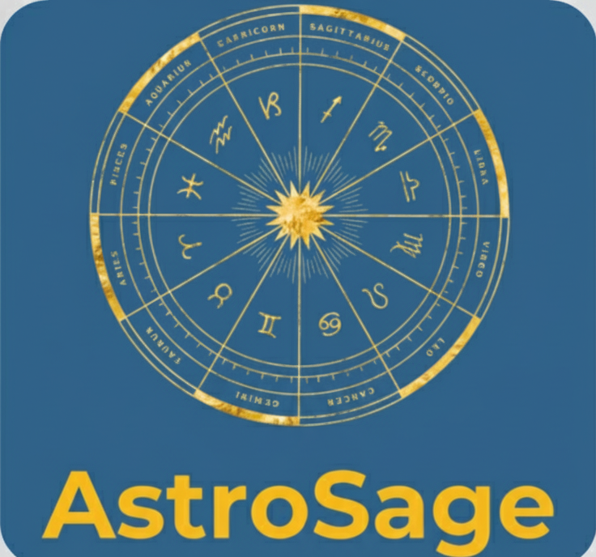
AstroSage Sales Analysis
Himanshu Goswami
22. 08. 2025

Slide 2
Contents:
Problem Statement
About AstroSage
Data Overview
Methodology
Understanding Our Call Traffic Flow
Understanding Our Weekly Call Cycle
Revenue Breakdown by Service
Analysis of Chat Completion Rates
Analysis of Chat Completion Rates
Analysis of Guru Rating Distribution
Analysis of User Rating Distribution
Identifying Our Elite Performers
Dashboard
Strategic Goals
The Bottom Line

Slide 3
The Strategic Challenge: Maximizing the Return on our ₹1 Crore Investment
The Context:
AstroSage has committed a significant ₹1 Crore investment to elevate our call center operations. Our current system is functional, but it has not been optimized to maximize customer satisfaction or profitability.
The Problem:
Without a data-driven strategy, there is a significant risk of misallocating this investment across competing priorities—hiring, training, and technology. We currently lack the deep insights needed to know which lever will have the greatest impact on our goals.

Slide 4
Introduction to AstroSage
AstroSage is a digital platform, accessible via its website and a dedicated app, that specializes in a range of astrological services. Key offerings include birth chart generation, horoscope compatibility analysis, and consultations with AI-powered astrologers.
AstroSage is used by many astrologers to create birth charts and match horoscopes.

Slide 5
Data Overview
Our primary goal is to leverage data for strategic investments that will increase sales turnover.
To do this, we are analyzing a dataset that tracks key metrics like operational costs, customer satisfaction, and sales trends.
This analysis is focused on AstroSage's current operational capacity, which includes 4 distinct consultation services.

Slide 6
Methodology
Data Cleaning: Utilized spreadsheet functions like TRIM and Remove Duplicates to ensure data accuracy and consistency.
Data Enrichment: Enhanced the dataset by creating new variables from date functions to enable more robust analysis.
Customer Segmentation: Performed customer segmentation by sorting and filtering data based on consultation type.
Performance Analysis: Leveraged Pivot Tables to analyze consultant performance across different categories, based on user ratings.
Visualization: Developed an interactive dashboard with various charts to provide a detailed, comprehensive view of the dataset.

Slide 7
Understanding Our Call Traffic Flow
This chart illustrates a clear daily pattern, with call volume peaking during business hours.
The busiest hour of the day is 8 AM, reaching a maximum of nearly 700 calls.
Activity is minimal during the late-night and early-morning hours, particularly between 12 AM and 4 AM.

Slide 8
Understanding Our Weekly Call Cycle
Call volume follows a distinct weekly cycle, peaking early in the week.
The busiest days are consistently Monday through Wednesday
Call traffic drops significantly on weekends.
A major slowdown occurs during the last week of December, which is critical for forecasting.

Slide 9
Revenue Breakdown by Service
The "Call" service is our primary profit center, generating 79% of all revenue.
"Chat" accounts for the remaining 21%, while other services currently produce no revenue.
Efforts should be prioritized on optimizing the "Call" and "Chat" services and re-evaluating the non-performing categories.

Slide 10
User Engagement by Platform
The mobile app is the dominant user platform, driving 91% of all call activity.
The "gurucool" website accounts for the remaining 9% of calls, while the "dashboard" currently generates none.
This confirms that development and strategic resources should be prioritized for the mobile app to maximize user engagement.

Slide 11
Analysis of Chat Completion Rates
A majority of chats (59%) are not successfully completed, highlighting a significant performance gap.
The main reasons for failure are agents not answering (21%) and technical issues (e.g., "busy" or "failed" statuses), which combined account for another 27%.
The key priorities are to improve agent response times and resolve the technical problems causing service failures.

Slide 12
Analysis of Guru Rating Distribution
The largest group of gurus has a rating of 0. This requires investigation to determine if they are new, inactive, or if this is a default system value.
For gurus who have been rated, the most common performance level is in the 2-3 star range.
Gurus with high ratings (4-8) represent a much smaller and distinct group, indicating that top-tier performance is rare.

Slide 13
Analysis of User Rating Distribution
The "Zero-Rated" Segment: A large portion of the user base (7,256 users) has a rating of 0. Understanding whether these are new users, unrated interactions, or a default state is a key opportunity.
Common Rating Behavior: For users who do provide a rating, feedback is most often in the average-to-low 2-3 star range, with high ratings (4-8) being significantly less common.

Slide 14
Identifying Our Elite Performers
A clear tier of top talent exists, led by Astro Pujaa Rai and Tarot Mystical, who both have a perfect average rating of 7.5.
The entire top 10 group is exceptionally strong, with all gurus maintaining an average rating above 5.0.
These top performers set a quality benchmark and offer valuable insights that can be used for training and improving the entire guru network.

Slide 15
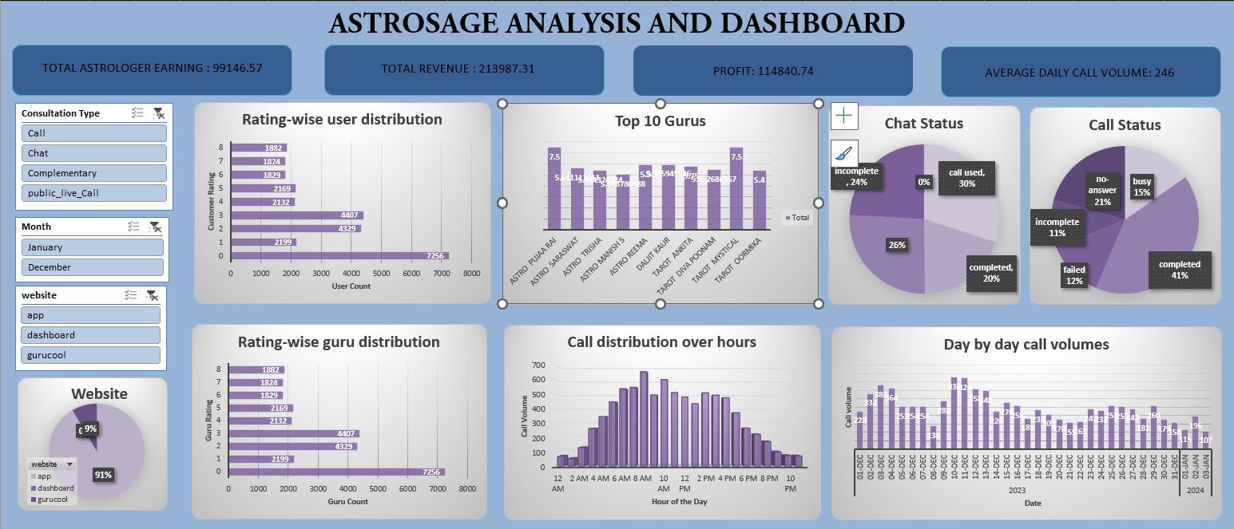

Slide 16
KPIs in Dashboard
Rating-wise user distribution
Call distribution over hours
Website distribution
Chat status
Rating-wise guru distribution
Revenue generated by different categories
Repeated vs non repeated users
Day by day call volumes
Top 10 Guru's ratings
Slicer for Consultation type
Total astrologer earning
Total revenue
Profit
Average daily call volume

Slide 17
Strategic Goals
Enhance Technological Infrastructure
Objective: Drive profitability by investing in app and dashboard upgrades.
Actions: Create a more engaging user experience to increase frequent use.
Optimize Consultation Channels
Objective: Maximize revenue from high-value services while reducing operational costs.
Actions: Deploy AI chatbots to handle general inquiries.
Implement a CRM-Powered Pre-Booking System
Objective: Streamline the user journey to boost satisfaction and loyalty.
Actions: Reduce repetitive introductory sessions and minimize wait times.

Slide 18
The Bottom Line
Invest in Technology to Boost Profitability: Upgrading our tech infrastructure and streamlining operations are the most direct paths to enhancing both customer satisfaction and overall profitability.
Automate and Personalize the User Journey: By implementing a pre-booking model with an integrated CRM, we can eliminate repetitive processes, increase efficiency, and create a more satisfying, personalized experience for our customers.
Leverage AI to Optimize Resources: Deploying AI-powered chatbots for general inquiries will significantly lower operational costs and free up our expert consultants to handle high-value interactions during peak demand.

Slide 19
Elevate Service Quality Through Continuous Training: To ensure consistent excellence, we must establish a formal training program based on the successes of our top-rated consultants. This creates a clear standard for quality across the platform.
Drive Holistic Business Improvement: Ultimately, these combined strategies are designed to achieve three core outcomes: improved operational efficiency, reduced costs, and a significantly enhanced customer experience.
Refine the Call Center for Maximum Satisfaction: The call consultation process must be improved. By implementing a better training model, consultants can deliver higher-quality consultations in less time, directly leading to increased customer satisfaction and better ratings.

